Slide 1
ESC101: Fundamentals of Computing
Welcome and Course Logistics
Piyush Rai

Slide 2
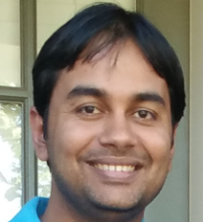
This Course
Introduction to computer programming/logic-based computing using the C Programming Language
Course Name: Fundamentals of Computing (ESC101), 14 credits
Instructor: Piyush Rai (CSE Department)
Email: piyush@cse.iitk.ac.in (don’t miss the “cse”)
For this course, will prefer all communication via Piazza
(Piazza supports private messages to instructors/students)
Tutors: 16 regular + 3 admin + 1 faculty tutor (all listed in later slides)

Slide 3
Purpose of This Course
Learning how to program using C programming language
Will do it with a mix of theory (lectures) and practical (programming labs)
Focus primarily on C programming but most concepts we will study apply to programming/logic-based computing in general
Assumes no prior background/exposure to programming
If you already have good proficiency in C programming, there will be an option of switching to Advanced Track (more info in later slides)

Slide 4
Course Schedule
Lectures: M,Tu,W 1200-1300 (in L-20)
Tutorial: Fri 1200-1300 (Tutorial Block rooms). More info in later slides
Labs: M/Tu/W/Th 1400-1700 (New Core Lab). You will attend only one of these 4 days depending on your section. More info in later slides
Lectures
(Mon,Tu,Wed)
Tutorial
(Friday)
Lab
(Next Week’s Mon/Tu/Wed/Thur)
Doubt-clearance session for the week’s lectures + minor quiz
Hands-on practice
of what you studied
the previous week

Slide 5
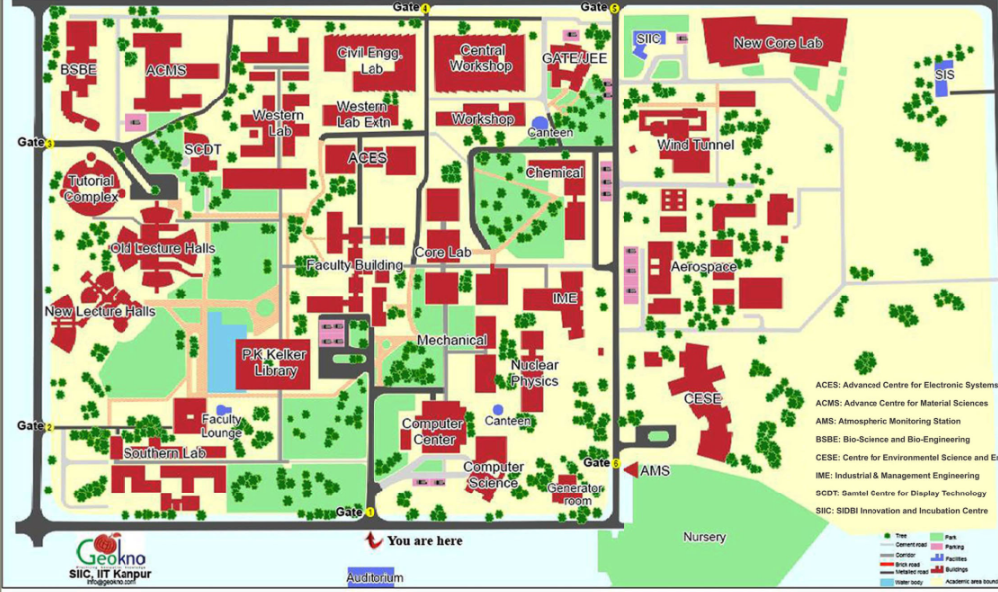
The Locations
New Core Lab
Tutorial
Block
New Lecture Halls (L20 and others)

Slide 6
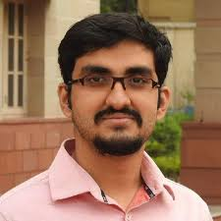
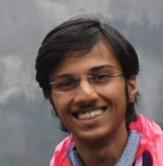
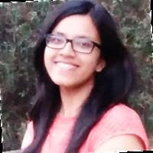
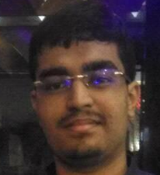
Regular Tutors
 | Avideep Mukherjee avideep@cse.iitk.ac.in Hindi, Bangla, English
 | Ayush Bansal ayushb@cse.iitk.ac.in Hindi, English
 | Gargi Singh sgargi@cse.iitk.ac.in Hindi, English
 | Garvit Gopal garvitg@cse.iitk.ac.in Hindi, English

Slide 7
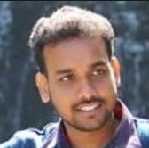
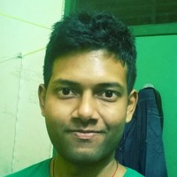
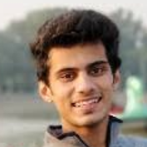
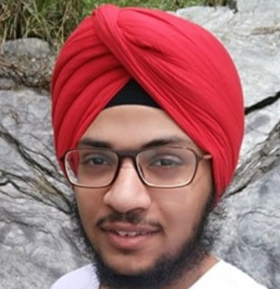
Regular Tutors
 | Kranti Kumar Parida kranti@cse.iitk.ac.in Hindi, Oriya, English
 | Manish Kumar Bera mkbera@cse.iitk.ac.in Hindi, English
 | Naman Verma namanv@cse.iitk.ac.in Hindi, English
 | Paramansh Singh params@cse.iitk.ac.in Hindi, Punjabi, English

Slide 8
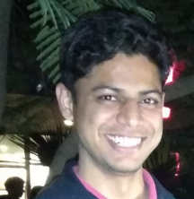
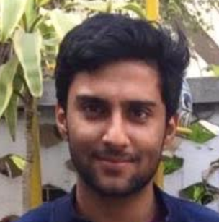
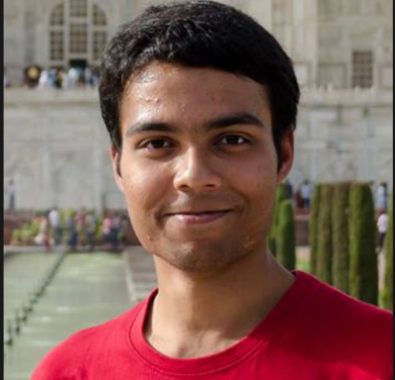
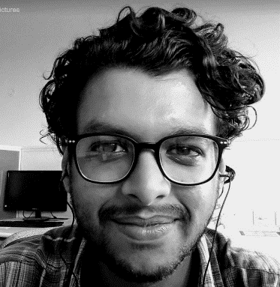
Regular Tutors
 | Prafulla Saxena prafulla@cse.iitk.ac.in Hindi, English
 | Raghukul Raman raghukul@cse.iitk.ac.in Hindi, English
 | Samik Some samik@cse.iitk.ac.in Hindi, English
 | Shivam Bansal sbansal@cse.iitk.ac.in Hindi, English

Slide 9
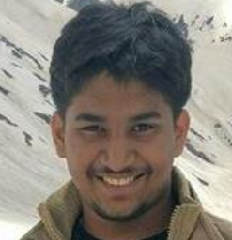
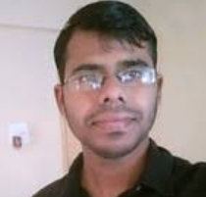
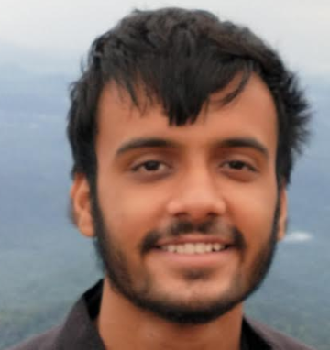

Regular Tutors
 | Utkarsh Barsayan butkarsh@iitk.ac.in Hindi, English
 | Vinayak Trivedi vinayakt@cse.iitk.ac.in Hindi, English
 | Yash Choudhary cyash@cse.iitk.ac.in Hindi, English
 | Yash Mahajan ymahajan@cse.iitk.ac.in Hindi, English

Slide 10
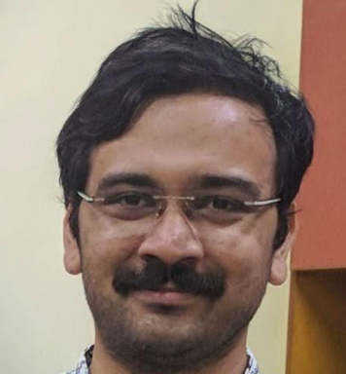
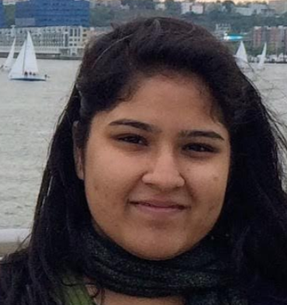
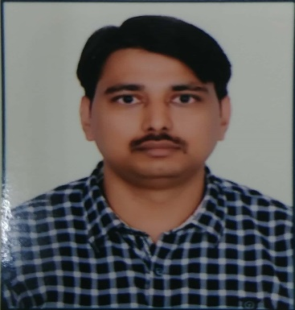
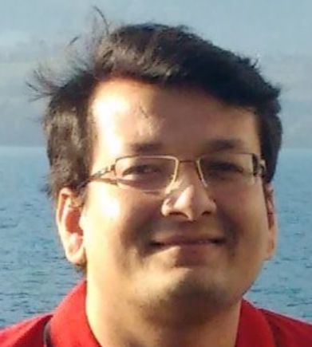
Admin and Faculty Tutors
 | Hrishikesh Terdalkar hrishirt@cse.iitk.ac.in Hindi, Marathi, English (Admin Tutor)
 | Shubhangi Agarwal sagarwal@cse.iitk.ac.in Hindi, English (Admin Tutor)
 | Nitin Kumar Singh nitinks@cse.iitk.ac.in Hindi, English (Admin Tutor)
 | Dr. Biswabandan Panda biswap@cse.iitk.ac.in Hindi, Odia, English (Faculty Tutor)

Slide 11
Tutorials
Tutorial (Every Fri 1200-1300): The tutorial room for each section
Tutorial will have doubt clearing session + examples on lecture material
For some tutorials, last 10-15 minutes will have a surprise minor quiz
The minor quizzes will be graded (grading policy later)
First tutorial on Friday this week (don’t worry; no quiz this Friday ☺ )
B1 | TB103
B2 | TB104
B3 | TB105
B4 | TB106
B5 | TB107
B6 | TB108
B7 | TB109
B8 | TB110
B9 | TB111
B10 | TB112
B11 | TB203
B12 | TB204
B13 | TB204
B14 | TBD

Slide 12
Labs
Lab days for each section will be as follows
In each lab, you will solve some programming problems
You will solve them on Prutor website (developed at IITK)
Lab will start at 1400. Must finish by 1700. Your solutions will be graded (grading policy later)
First week’s lab: Not graded. ☺ Just familiarize yourself with Prutor system
Monday | Tuesday | Wednesday | Thursday:
B1, B2, B3 | B4, B5, B6, B13 | B10, B11, B12, B14 | B7, B8, B9

Slide 13
Labs
Must solve lab questions on your own
Be careful - no sharing of code
Practice Set: Released each week to help students prepare for next week's lab problems
Each lab will have TA and Tutors for invigilation/logistical help
If no lab due to a holiday, will have a make-up lab on weekend (Sat/Sun)

Slide 14
Grading Scheme
Minor Quizzes (best 8 of total 10): 8%
Conducted during tutorial hours
2 Major Quizzes (Aug 28, Oct 30): 10%
Conducted during lecture hours
Mid-sem Theory Exam: 15%
Date will be announced by DOAA
End-sem Theory Exam: 25%
Date will be announced by DOAA
Lab Assignments (best 10 of total 13): 10%
Mid-sem Lab Exam: 15%
Date: Sept 8
End-sem Lab Exam: 17%
Date: Nov 3
Theory: 58%
Practical: 42%

Slide 15
Useful Links (please bookmark them)

Slide 16
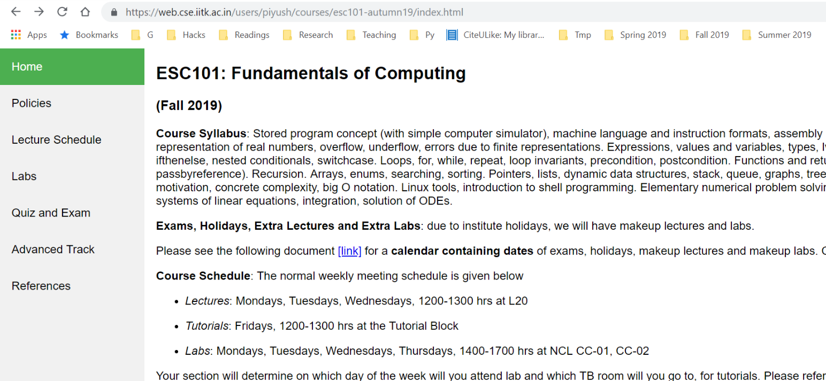
Course Website
Course website: https://tinyurl.com/esc19-20w
All course material will be posted here (slides, quiz/exam solutions, etc). Also refer to the webpage for other information (Policy etc)
Accessible only internally from IITK. For external access, will need VPN

Slide 17
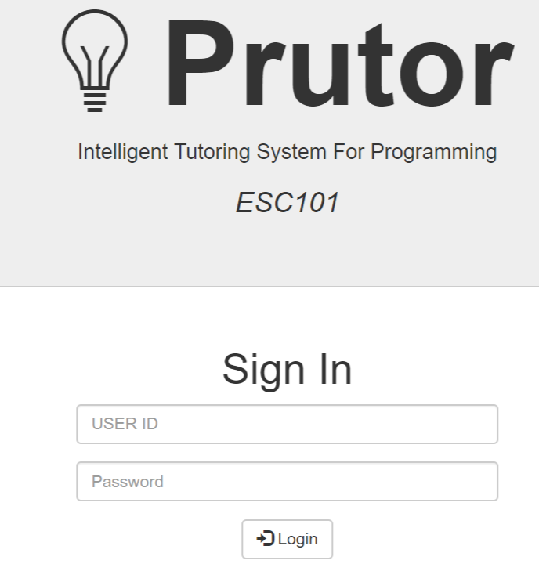
Lab Website (Prutor)
https://esc101.cse.iitk.ac.in . Will be using it for weekly lab exercises, lab exams, lab practice, etc
Your marks for weekly labs and lab exams will also be shown on Prutor
Accessible only internally from IITK. For external access, will need proxy
User ID: your IITK login
Password: your CC password

Slide 18
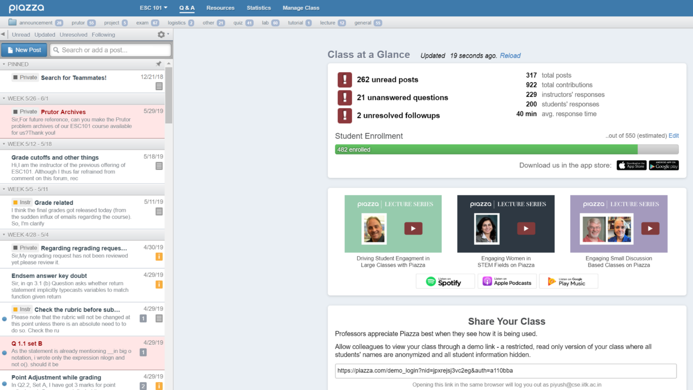
Online Discussion Webpage (Piazza)
https://piazza.com/class/jxr8tyls8rmm8
Accessible from anywhere (also has a mobile app)
Can set message notifications to real-time or digest mode
Have already added you
(using your IITK email id).
Please choose a password
and start using Piazza

Slide 19
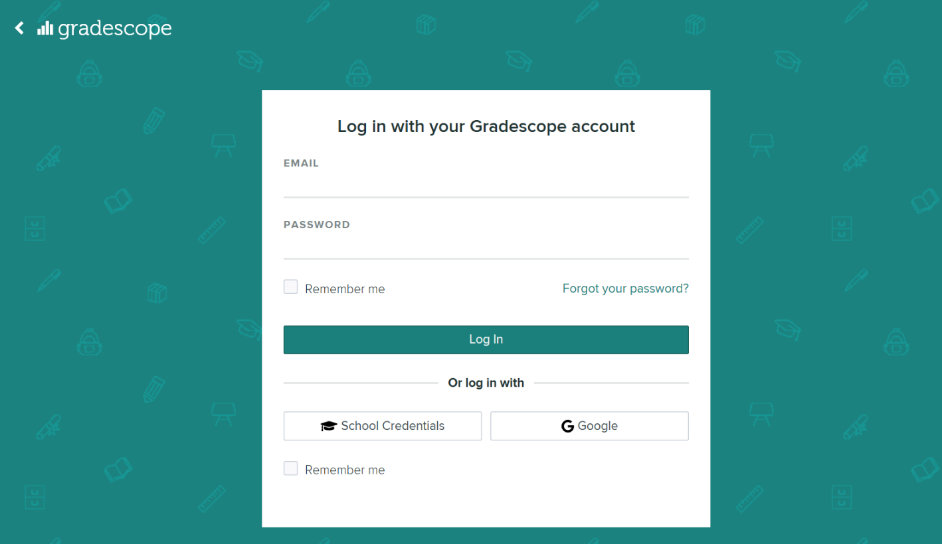
Grading Website (Gradescope)
https://www.gradescope.com/
For grading and showing graded quiz/exam copies online
Students can place regrading requests online
Will share login
and password soon

Slide 20
Course Mailing List
esc101@iitk.ac.in
You must already be signed up for this list (with your IITK email)
All course-related announcements will be sent on this (and on Piazza)
Only instructors can post messages on this mailing list (you can only receive messages)

Slide 21
Textbooks
Several nice books on C. You may pick one of these
Schaum's Outline of Programming with C by Byron Gottfried, McGraw-Hill India.
The C Programming Language by Kernighan and Ritchie, PH India.
Refer to course website for some other references
Advice: Pick one reference book and stick to it throughout

Slide 22
Advanced Track (AT)
For students who already have good proficiency in C programming
Can replace minor quiz and labs with a project (18% course weightage)
Candidates for this track will be selected with a C programming based screening test. Appearing in the test is optional
10th August, 9 am in New Core Labs
Will circulate an excel sheet to mark your interest
Even if selected for AT, can re-join regular track by October 27, 2019
With satisfactory project evaluation: 100% score on missed quizzes/labs
With unsatisfactory project evaluation: Average class score on all missed assignments

Slide 23
Some Course-related Policies (please follow them carefully) (more info on course website)

Slide 24
Policy on Conduct of Labs/Quizzes/Exams
Quizzes/exams will be open handwritten notes. You may bring your notebook (must use your own notes)
No printed/photocopied material or electronic material will be allowed in quizzes/exams
During lab hours, only students sitting inside NCL labs will be able to access Prutor
But outside of lab hours, Prutor is available at CC/NCL/Halls, etc

Slide 25
Copying
Please be sincere and honest. Please do not copy.
.. in any component (lab/quiz/exams/lab exams)
If you are caught, you get penalized on grade (most likely F grade).
Will not be allowed to drop the course
Case reported to DoAA/SSAC
No warning or second chance
All parties involved in copying will be held equally responsible. Copying from internet is penalized equally.
Policy may change on need basis

Slide 26
Copying: How to Avoid?
Read-protect your directories so that others cannot copy from your directory
Do not share your CC password with friends
Do not leave printouts, notes etc. containing your code unattended
Never hard code inputs in your program (more on this later in the semester)
Use of electronic devices such as mobile phones, tablets, smart watches, etc is not allowed during labs/quizzes/exams and will count as cheating
Refer to the course webpage for more information

Slide 27
Absentee Policy
Absence from a quiz/lab/exam, requires approval from SUGC/Instructor
Minor quizzes: No makeup. Best 8 out of 10 quizzes to be counted.
Major quizzes: Prorated from the nearest future mid-sem or end-sem exam
Labs: No makeup. Best10 out of 13 quizzes to be counted.
Mid term lab exam: Prorated by final lab exam
Final lab exam: Prorated by End sem exam
Mid-sem: Prorated by End-sem.
End-sem: Makeup, as per DoAA's schedule
Policy may change on need basis (see course website for more details)

Slide 28
Course Drop Policy
Must get course drop applications approved by the instructor by October 14, 2019 after giving proper reason for said drop.
Drop applications must be filled out on the standard SUGC drop form
October 14, 2019 is a senate deadline. Can’t drop after this deadline
Instructor can’t ensure approval of a drop by DUGC convenors or SUGC

Slide 29
Acknowledgement
Previous instructors of ESC101
Purushottam Kar, Swaprava Nath, Nisheeth Srivastava, Indranil Saha, Amey Karkare, and others
Amey Karkare and his students (especially Umair Ahmed) for Prutor and autograding features of Prutor

